Slide 1
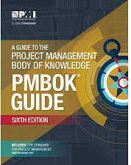
Software Project Management
6th Edition
Lecture 2
PM Tools
Project Management Institute

Slide 2
Objectives – Lecture 2
Introduction of PM Tools

Slide 3
Project Management Tools
“Tool" is any self-contained concept, practice, technique, or software package that can be applied independently to a software project, in order to improve the way it is performed [1].
Risk management, for example, is as much of a tool as Microsoft Project or Subversion.
Notes:
Most people think of a tool as a piece of software that can be used to manage a project schedule, track defects, or automate other tasks, in order to increase productivity on a project.
1. The idea behind these tools and techniques is to allow a project manager to pick and choose only those practices that solve the specific problems she is having with her own projects.
2. can be implemented by a single person, either working alone or in a team environment.
3.

Slide 4
Why Use Project Management Tools and Techniques?
Focus and clarify our thinking so that we proceed in a systematic, effective, and efficient manner
Identify everything that needs to be considered and done to reach a goal (includes what is to be communicated and to whom)
Identify who will do what and time frames
Reduce the confusion, frustration, backtracking, and errors that can be associated with developing or introducing something new

Slide 5
Project Management Tools and Techniques
Project management tools and techniques assist project managers and their teams in various aspects of project management
Some specific ones include:
Project charter, scope statement, and WBS (scope)
Gantt charts, network diagrams, critical path analysis, critical chain scheduling (time)
Cost estimates and earned value management (cost)

Slide 6
Super Tools
“Super tools” are those tools that have high use and high potential for improving project success, such as:
Software for task scheduling (such as project management software)
Scope statements
Requirements analyses
Lessons-learned reports
Tools already extensively used that have been found to improve project importance include:
Progress reports
Kick-off meetings
Gantt charts
Change requests

Slide 7
PM Tools: Software
Low-end
Handle single or smaller projects well, cost under $200 per user
Basic features, tasks management, charting
MS Excel, Milestones Simplicity
Mid-market
Handle larger projects, multiple projects and users, analysis tools
MS Project (approx. 50% of market)
cost $200-600 per user, Project 2007 most popular

Slide 8
PM tools and techniques
Project management tools and techniques assist project managers and their teams in carrying out work in all knowledge areas. For example, some popular time- management tools and techniques include Gantt charts, project network diagrams, and critical path analysis.
Low-end
Basic features, tasks management, charting
MS Excel, Milestones Simplicity
Mid-market
Handle larger projects, multiple projects, analysis tools
MS Project (approx. 50% of market)
High-end
Very large projects, specialized needs, enterprise
AMS Realtime
Primavera Project Manager

Slide 9
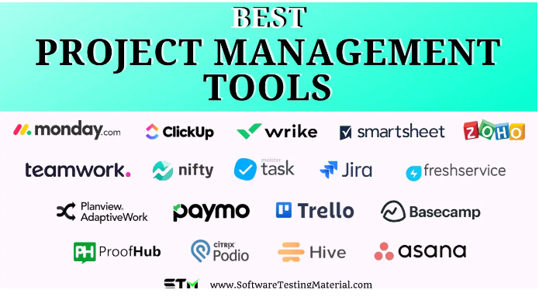

Slide 10
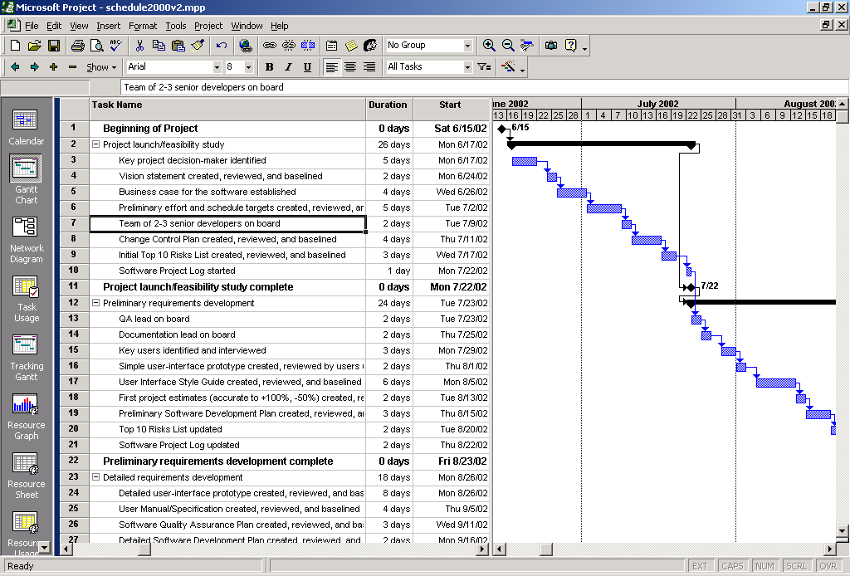
Tools: Gantt Chart

Slide 11
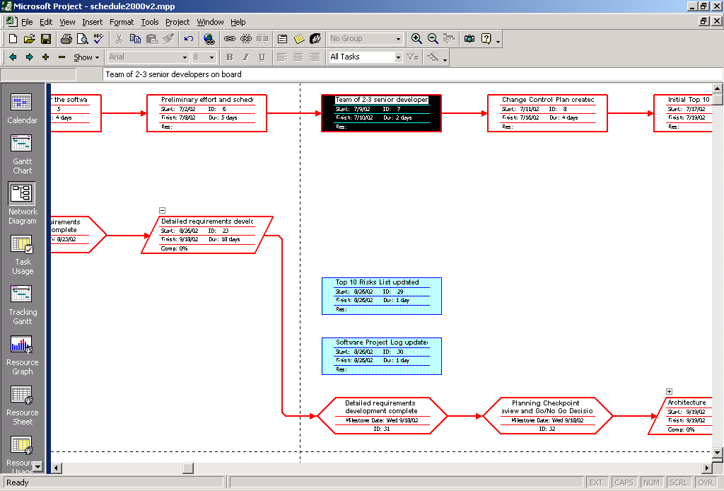
Tools: Network Diagram

Slide 12
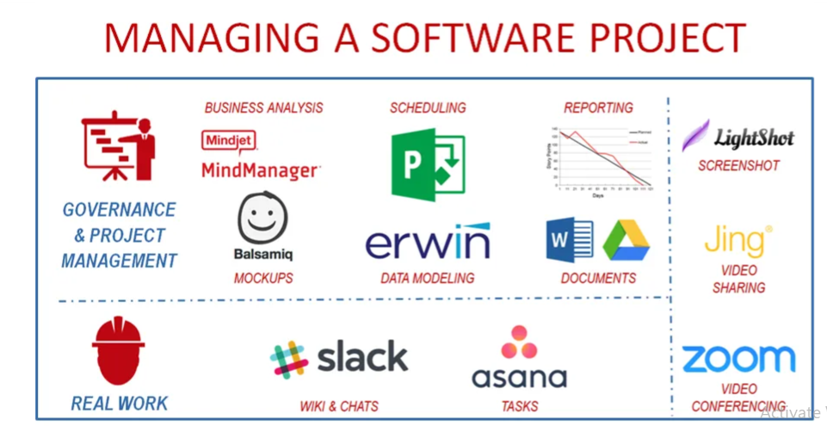

Slide 13
Trello
Best For: Simple task management and small to medium-sized teams.
Features: Trello uses a visual board and card system to manage tasks. It's highly intuitive, with drag-and-drop functionality, and allows for easy collaboration through comments, attachments, and checklists.
Pros: User-friendly, flexible, and integrates with many other tools like Slack, Google Drive, and more.
Cons: Limited features for complex project management and reporting.

Slide 14
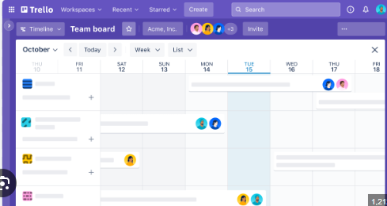
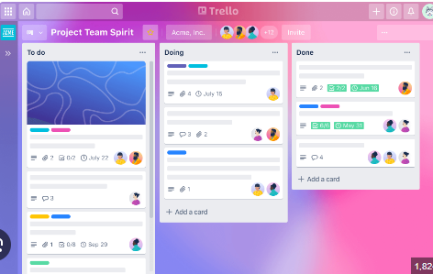

Slide 15
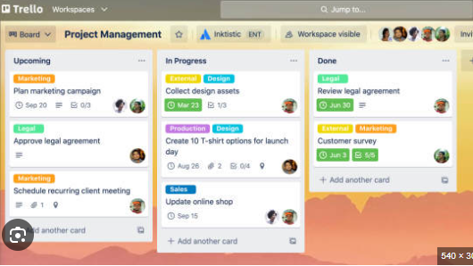

Slide 16
Asana
Best For: Task and workflow management, suitable for teams of all sizes.
Features: Asana offers task management, project tracking, timelines, and kanban boards. It's known for its flexibility and ability to handle a wide variety of workflows.
Pros: Strong collaboration features, customizable workflows, and robust integration options.
Cons: Can be overwhelming for new users due to the number of features.

Slide 17
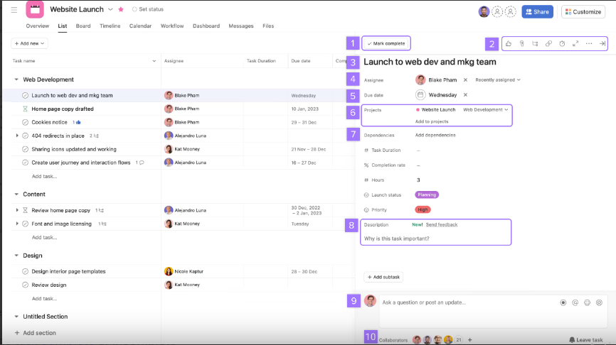

Slide 18
Jira
Best For: Agile software development teams.
Features: Jira is tailored for software development, with features like Scrum boards, Kanban boards, and detailed issue tracking. It also offers customizable workflows and strong reporting capabilities.
Pros: Excellent for managing software projects, highly customizable, integrates with many development tools like Bitbucket and Confluence.
Cons: Steep learning curve, more complex than other tools, especially for non-developers.

Slide 19
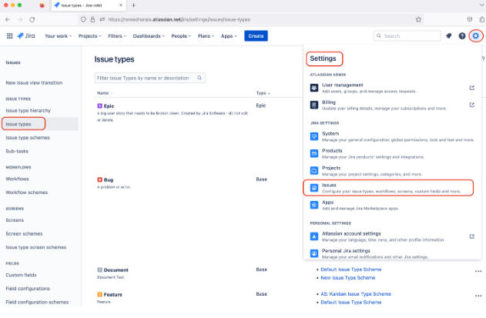

Slide 20
Microsoft Project
Best For: Large and complex projects.
Key Features: Detailed scheduling, resource management, budget tracking, Gantt charts, and advanced reporting capabilities.
Why It’s Great: Microsoft Project is powerful and comprehensive, making it suitable for managing large-scale projects with complex timelines and resource needs.

Slide 21
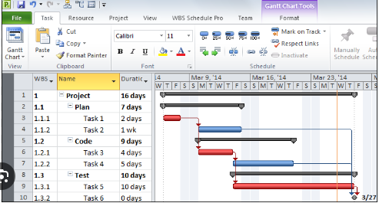

Slide 22
ClickUp
Best For: All-in-one project management.
Key Features: Task management, time tracking, goal setting, docs and wikis, and integrations with various tools.
Why It’s Great: ClickUp is highly versatile, offering a wide range of features that make it suitable for teams of all sizes and industries, allowing you to manage everything in one place.

Slide 23
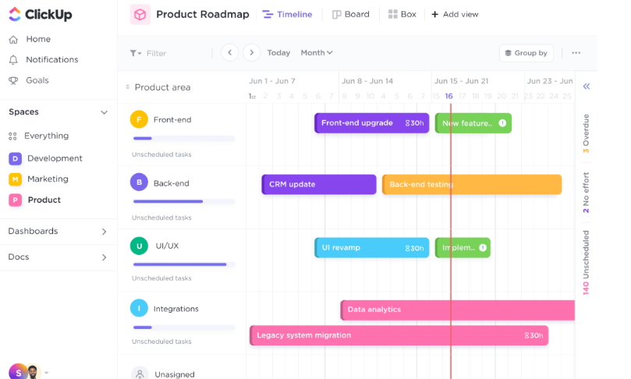
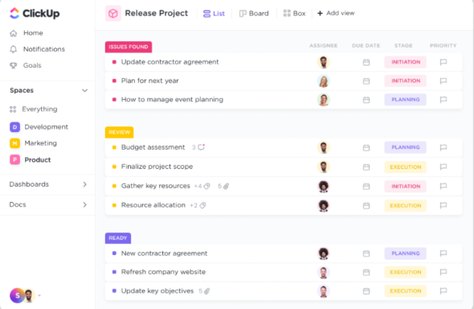

Slide 24
Smartsheet
Best For: Spreadsheet-like project management.
Key Features: Gantt charts, automated workflows, resource management, reporting, and real-time collaboration.
Why It’s Great: Smartsheet combines the familiarity of spreadsheets with advanced project management features, making it ideal for teams that prefer working in a spreadsheet format.

Slide 25
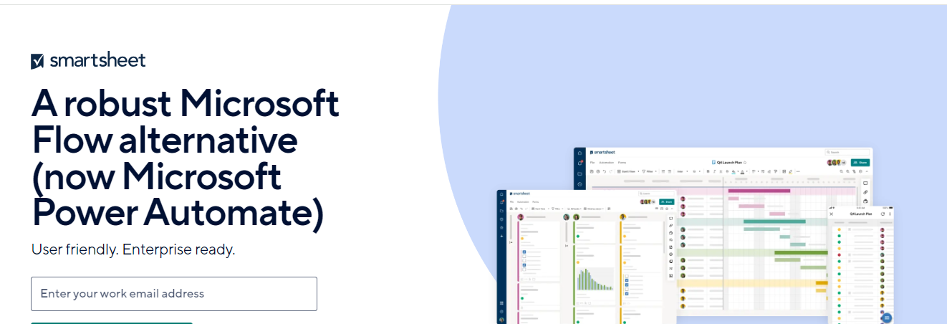

Slide 26
Basecamp
Best For: Simple project management and team communication.
Key Features: To-do lists, message boards, schedules, document sharing, and real-time group chat.
Why It’s Great: Basecamp is easy to use and focuses on communication and task management, making it great for small to medium-sized teams.

Slide 27
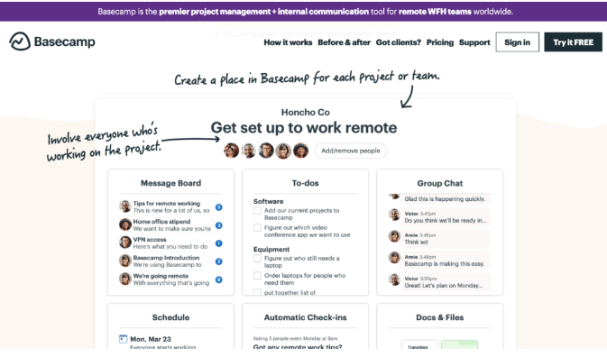

Slide 28
Wrike
Best For: Teams needing extensive customization and robust reporting.
Key Features: Custom workflows, Gantt charts, time tracking, real-time reporting, and document management.
Why It’s Great: Wrike offers powerful customization options and is particularly strong in its reporting and analytics capabilities, making it suitable for teams that need detailed insights into their projects.

Slide 29
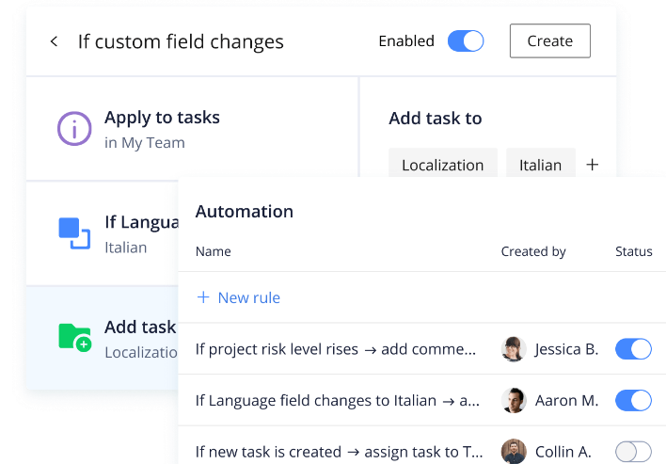

Slide 30
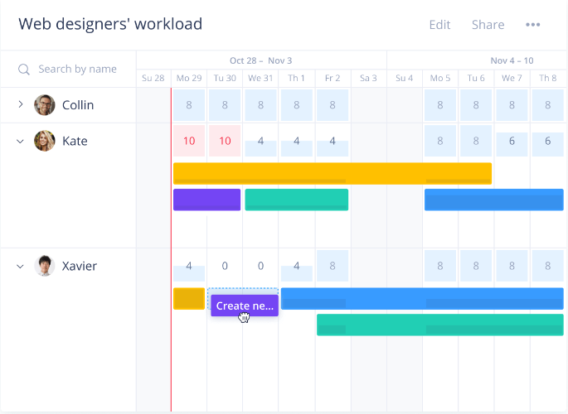

Slide 31
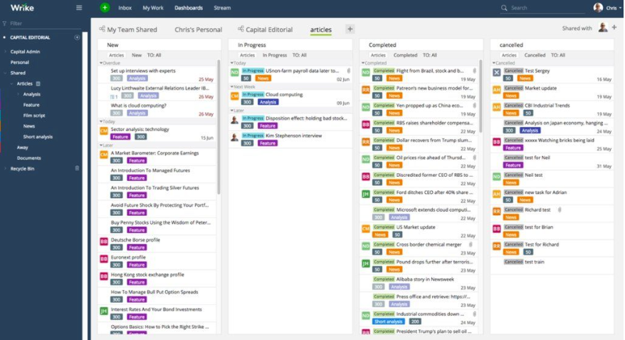

Slide 32
Notion
Best For: Combining project management with knowledge management.
Key Features: Task management, wikis, databases, note-taking, and collaboration.
Why It’s Great: Notion is highly versatile and allows teams to manage projects, documents, and knowledge bases in one unified platform, making it ideal for teams that value flexibility and organization.
Each of these tools has its own strengths, so the best choice depends on your specific project management needs and preferences.

Slide 33
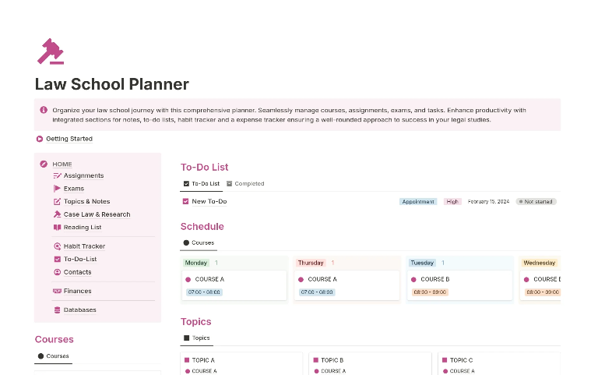

Slide 34
Bugzilla
Bugzilla is a web-based bug tracking tool developed by the Mozilla Foundation. It is widely used in software development projects for tracking and managing software defects (bugs) and feature requests. Bugzilla is known for its robustness, flexibility, and ability to handle large-scale projects.
Bug Tracking,Search and Reporting,Workflow Management,Integration (Version Controlling and API’s),Security,OpenSource,Scalability,Customization,Community Support

Slide 35
Use Cases:
Software Development: Primarily used in software development projects to track bugs and manage feature requests.
Quality Assurance (QA) Teams: QA teams use Bugzilla to report, track, and verify bugs during testing phases.
Open Source Projects: Many open-source projects, including Mozilla Firefox, use Bugzilla to manage bugs and development tasks.

Slide 36
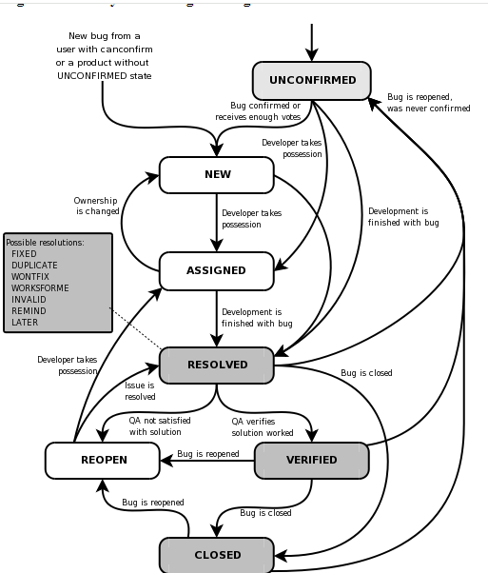

Slide 37
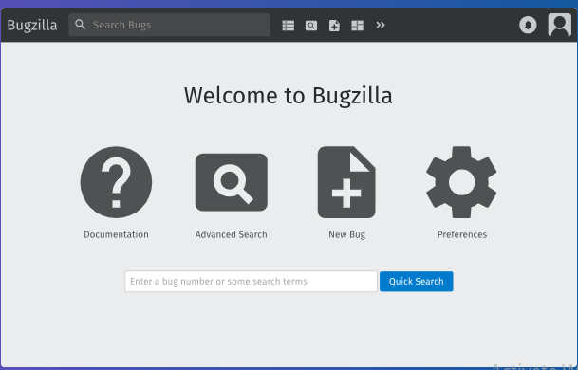
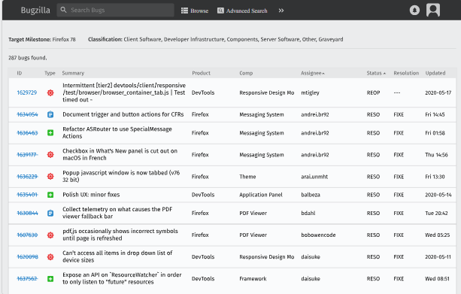

Slide 38
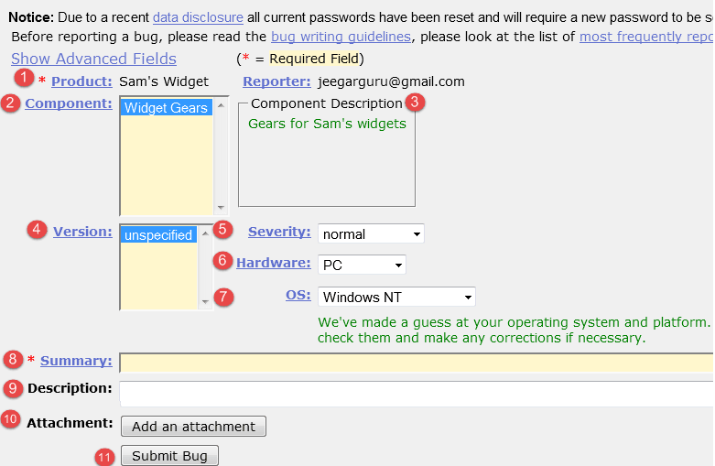
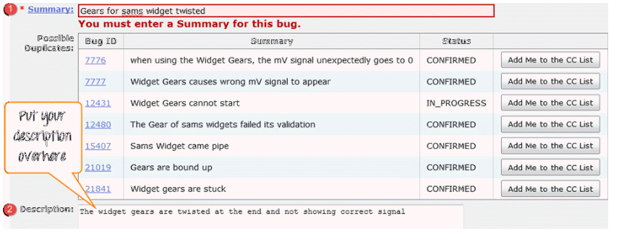

Slide 39
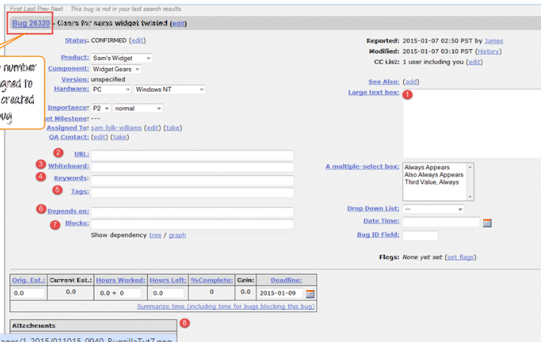

Slide 40
